Slide 1
One Somerset Programme - Overview & Update June 2, 2020 - Dr Carlton Brand, Programme Director

Slide 2
Overview – One Somerset Programme
Our Somerset community challenges
Future of Local Government in Somerset (FoLGiS)
Why Local Government Reform (LGR)?
Where are we in Somerset?
One Somerset – LGR time line and Business case delivery work plan
Business case democratic governance process & approval dates
Engagement plan – to assess local support
SALC / SLCC / Frome Parish Conference: working with T&PCs - 7 Recommendations
Proposed Local Community Networks
County and District Council service integration
Unitary council annual savings profile
Discussion and Q&A

Slide 3
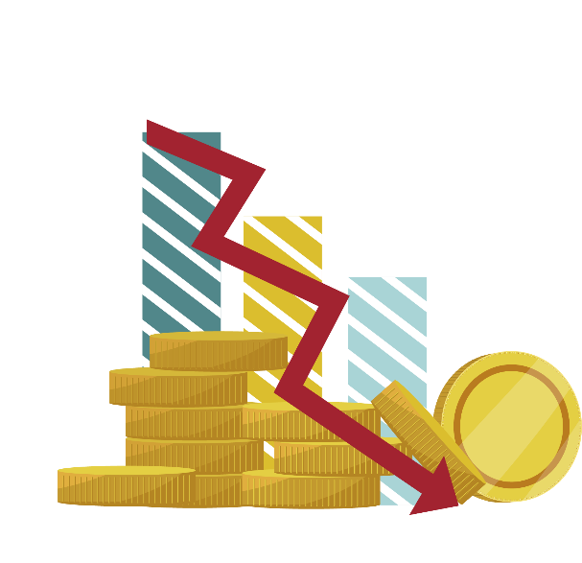
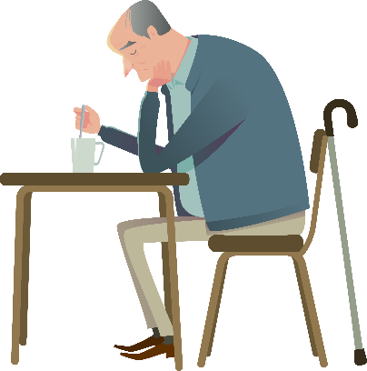
Our Somerset Community Challenges
Disadvantaged Children
Young People
16-24
The Economy
Social Mobility
Poverty and Deprivation
Troubled Families
Higher Education
Self Harm
Affordable Housing
Low Wage/Low Skill
Low Productivity
Digital Connectivity
Travel
Affordable Housing
Fact: 14,000 troubled families
Fact: 529 looked after children
Fact: our young people are twice as likely to end up in hospital as a result of self harm
Fact: Average earnings are £2,226 less per year than the national average
Older People
The Environment
Increase in Older People
Quality of Health
Isolation
Carbon Neutral Councils
Carbon Emissions
Flooding
Fact: 30% increase in people aged 65-84 by 2035; 88% increase over 85s

Slide 4
Future of Local Government in Somerset (FoLGiS)
FoLGiS report commissioned by all Somerset Councils in 2018
Reported in 2019 and published early 2020
All political leaders and CEOs were part of this
Overarching conclusion supported by all councils that maintaining the status quo was not an option
Somerset faces some big challenges over the next 5-20 years, and a modern 21st century approach to local governance and service delivery is required for the county to thrive and grow

Slide 5
Why Local Government Reform?
One council - to listen to the people of Somerset
One voice – to represent Somerset’s communities, businesses and new business
One commitment – to drive community decision making and responsibilities
One promise – to deliver better public services, integrated service improvement and a single pathway for service users
One back office - delivering savings that can then be invested where you live.
One HR, One IT, One Finance, One set of directors, one CEO – why have five when you could have ONE?

Slide 6
Where are we in Somerset?
Covid-19: experience of ’virtual unitary’, central / local government funding unsustainable
MHCLG meeting with Local Government Minister of State, Simon Clarke MP
Devolution White Paper 2020; LGR supports this. Part of COVID-19 response
Pioneer Somerset (past collaboration between 5 councils didn’t deliver)
Heart of the South West – external partnerships are vital
Somerset Waste Partnership (a strong example of a one service solution)

Slide 7
One Somerset - LGR Timeline
 | 2020 |  |  |  | 2021 |  |  |  | 2022
 | Q1 | Q2 | Q3 | Q4 | Q1 | Q2 | Q3 | Q4 | Q1 | Q2 | Q3 | Q4
Business Case
Implementation Phase |  |  |  |  |  | Shadow executive in place
Transformation Phase
LCN boundaries
And definition

Slide 8
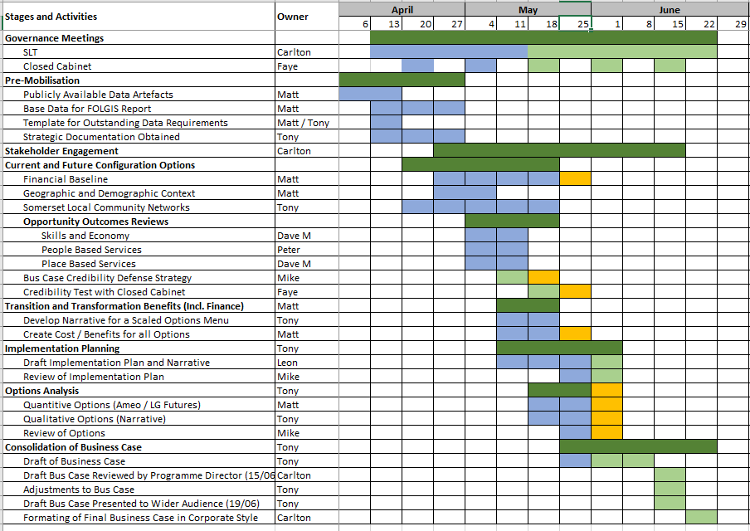
One Somerset – Business case delivery plan

Slide 9
Business case democratic process timing
Scrutiny - 10 June
Invitation from Secretary of State to all Somerset councils – June ?
Business case available - w/c 29 June
Informal member briefings from July 1
Scrutiny - 15 July
Cabinet - 20 July
Council – 29 July
Secretary of State submission – end July

Slide 10
Engagement Plan – to assess local support
Engagement with some town and parish councils and partners pre-Covid
Facilitated by an external research company, to provide an independent voice
External supplier research engagement starts June 2. Interim report 10 June, final report 17 June
Engagement sessions and communications both internally and externally, with residents, businesses and our partners
Information sessions with SCC staff
Town/Parishes, local businesses, voluntary community sector, residents, Your Somerset feedback
Strategic partner support (Police, PCC, Fire, Health, others)

Slide 11
SALC/SLCC/Frome Parish Conference: Recommendations
1. A Charter for Somerset
2. Local ownership and devolution (assets and services)
3. Localism and solutions
4. Local governance
5. Local presence
6. Trust and partnership
7. Parishes working together
All of these recommendations will be built into the business case

Slide 12
Local Community Networks (LCNs)
A fundamental part of the unitary bid (strategic and very local)
Not new; all county unitaries have these
Committees of cabinet with decision making powers
Between 4-9 local unitary members on each LCN. Community leadership
A forum for local discussion, action, oversight, listening
6-7 public meetings per year; working between meetings
Supported by a dedicated LCN senior manager for each
JSNA data, evidence driven; local issues; members’ priorities
Attended by Council, Police, Health, Town & parish councils, VCS and the public

Slide 13
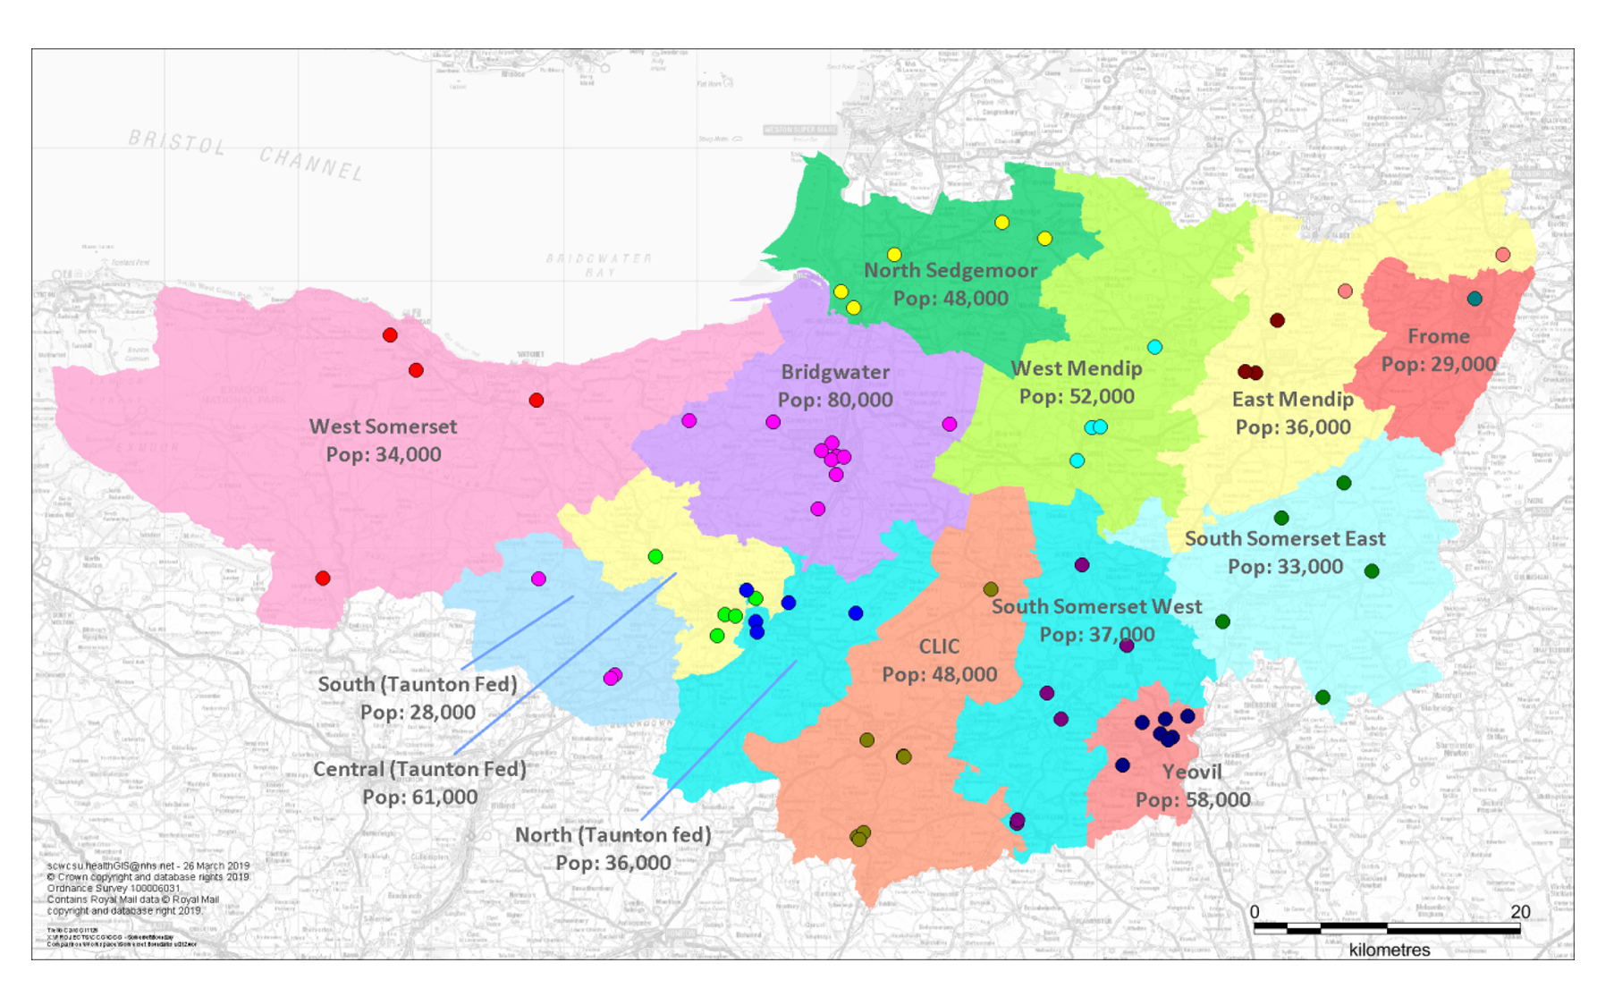
Proposed LCN number and boundaries. (a starting point)
(Current CCG Neighbourhoods / Primary Care Networks)

Slide 14
County & District Council Service Integration Opportunities
Planning — 1 local development plan in lieu of 5, incl. waste, minerals
Housing — integrated with social care commissioning
Environmental health & Trading standards — integrated with Public health (to affect the wider determinants of health and well being)
Licensing — integrated with Public Health (to affect the wider determinants of health and well being)
Leisure — Integrated with Public health (to affect the wider determinants of health and well being)
Support services – single, integrated across the Council

Slide 15
Planning
This is an important design consideration for the business case
Other unitary counties have:
5 planning committees (the old district areas)
1 strategic planning committee (county wide)
However,
This would represent a backward step for some Somerset areas
We need to think about and engage towns & parishes more
LCNs are the wrong place for planning (they become overwhelmed)

Slide 16
Unitary Council Annual Savings (under development)
 | Somerset Current | Bucks |  | Dorset | Leicestershire
Democratic | £1.3 million | £1.6 million | (-0.3) | £0.6 million | £1.3 million
Senior Management | £2.9 million | £3.0 million | (-0.1) | £10.1 million | £5.6 million
Corporate Services | £4.4 million | £4.0 million | (+0.4) |  | £17.4 million
IT | £1.5 million | £1.7 million | (-0.2) | £0.2 million
Accommodation | £1 million | £1.5 million | (-0.5) | £0.2 million
Contracts | £3.3 million | £2.8 million | (+0.5) | -
Service Consolidation | £4.4 million | £3.76 million | (+0.6) | £2.5 million | £8.5 million
 |  | - | - |  | -
Total | £18.7million | £18.2 million |  | £13.6 million | £30 million (-£2.8 million contingency)

Slide 17
Discussion and Q&A

